Slide 1
Counting
Assume we have a set of objects with certain properties
• Counting is used to determine the number of these objects
Examples:
Number of available phone numbers with 11 digits in the local calling area.

Slide 2
Basic Counting Rules
Counting problems may be very hard, not obvious
• Solution:
– simplify the solution by decomposing the problem
• Two basic decomposition rules:
– Product rule
• A count decomposes into a sequence of dependent counts
(“each element in the first count is associated with all
elements of the second count”)
– Sum rule
• A count decomposes into a set of independent counts
(“elements of counts are alternatives”)

Slide 3
Product Rule
A count can be broken down into a sequence of dependent counts
• “each element in the first count is associated with all
elements of the second count”
Example:
• Assume an auditorium with a seat labeled by a letter and
numbers in between 1 to 50 (e.g. A23). We want the total
number of seats in the auditorium.
• 26 letters and 50 numbers
• How to count?

Slide 4
Product Rule
Example:
• Assume an auditorium with a seat labeled by a letter and
numbers in between 1 to 50 (e.g. A23). We want the total
number of seats in the auditorium.
• 26 letters and 50 numbers
• How to count?
• One solution: write down all seats (objects) and count them
A-1 A-2 A-3 …A-50 B-1… Z-49 Z-50
1 2 3 50 51 … (n-1) n ← eventually we get it

Slide 5
Product Rule
• 26 letters and 50 numbers
• How to count?
• One solution: write down all seats (objects) and count them
A-1 A-2 A-3 …A-50 B-1… Z-49 Z-50
1 2 3 50 51 … (n-1) n ← eventually we get it
• A better solution?
• For each letter there are 50 numbers
• So the number of seats is 26*50 = 1300
• Product rule: number of letters * number of integers in [1,50]

Slide 6
Product Rule
A count can be broken down into a sequence of dependent counts
• “each element in the first count is associated with all
elements of the second count”
Product rule: If a count of elements can be broken down into a sequence of dependent counts where the first count yields n1 elements, the second n2 elements, and kth count nk elements, by the product rule the total number of elements is:
• n = n1*n2* …* nk

Slide 7
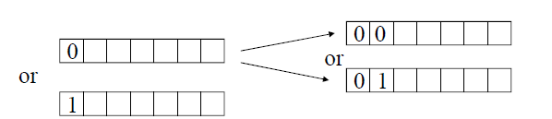
Product Rule
Example:
• How many different bit strings of length 7 are there?
• E.g. 1011010
• Is it possible to decompose the count problem and if yes how?
• Yes.
– Count the number of possible assignments to bit 1
– For the specific first bit count possible assignments to bit 2
– For the specific first two bits count assignments to bit 3
– Number of assignments to the first 3 bits: 2*2*2=8

Slide 8
Product Rule
Example:
• How many different bit strings of length 7 are there?
• E.g. 1011010
• Is it possible to decompose the count problem and if yes how?
• Yes.
– Count the number of possible assignments to bit 1
– For the specific first bit count possible assignments to bit 2
– For the specific first two bits count assignments to bit 3
– Gives a sequence of n dependent counts and by the product rule we have: n = 2* 2 * 2 * 2 * 2 * 2 *2 = 2⁷

Slide 9
Product Rule
Example:
The number of subsets of a set S with k elements.
• Assume each element in S is assigned a bit position.
• If A is a subset it can be encoded as a bitstring: if an element is in A then use 1 else put 0
• How many different bitstrings are there?
– n = 2* 2* …2 = 2^{k}
k-element

Slide 10
Sum Rule
A count decomposes into a set of independent counts
• “elements of counts are alternatives”, they do not depend on
each other.
Example:
• You need to travel in between city A and B. You can either fly, take a train, or a bus. There are 3 different flights in between A and B, 2 different trains and 10 buses. How many options do you have to get from A to B?
• We can take only one type of transportation and for each only one option. The number of options:
• n = 3+2+10
Sum rule:
• n = number of flights + number of trains + number of buses

Slide 11
Sum Rule
A count decomposes into a set of independent counts
• “elements of counts are alternatives”
• Sum rule: If a count of elements can be broken down into a set of independent counts where the first count yields n1 elements, the second n2 elements, and kth count nk elements, by the sum rule the total number of elements is:
• n = n1+n2+ …+ nk

Slide 12
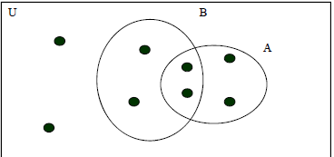
Inclusion Exclusion Principle
Used in counts where the decomposition yields two dependent count tasks with overlapping elements
• If we used the sum rule some elements would be counted twice
Inclusion-exclusion principle: uses a sum rule and then corrects for the overlapping elements.
We used the principle for the cardinality of the set union.
• |A U B| = |A| + |B| - |A ∩ B|

Slide 13
Inclusion Exclusion Principle
Example: How many bitstrings of length 8 start either with a bit 1 or end with 00?
• It is easy to count strings that start with 1:
• How many are there? 2⁷
• It is easy to count the strings that end with 00.
• How many are there? 2⁶
• Is it OK to add the two numbers to get the answer? 2⁷ + 2⁶
• No. Overcount. There are some strings that can both start with 1 and end with 00. These strings are counted in twice.
• How to deal with it? How to correct for overlap?
• How many of strings were counted twice? 2⁵ (1 xxxxx 00)
• Thus we can correct for the overlap simply by using:
• 2⁷ + 2⁶ – 2⁵ = 128+ 64-32 = 160

Slide 14
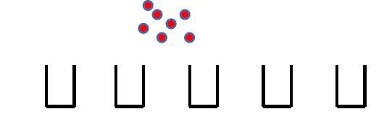
Pigeonhole principle
Assume you have a set of objects and a set of bins used to store objects.
• The pigeonhole principle states that if there are more objects than bins then there is at least one bin with more than one object.
• Example: 7 balls and 5 bins to store them

Slide 15

Pigeonhole principle
Assume you have a set of objects and a set of bins used to store objects.
• The pigeonhole principle states that if there are more objects than bins then there is at least one bin with more than one object.
• Example: 7 balls and 5 bins to store them
At least one bin with more than 1 ball exists.

Slide 16

Pigeonhole principle
Assume you have a set of objects and a set of bins used to store objects. The pigeonhole principle states that if there are more objects than bins then there is at least one bin with more than one object.
• Theorem. If there are k+1 objects and k bins. Then there is at least one bin with two or more objects.

Slide 17
Pigeonhole principle
Assume you have a set of objects and a set of bins used to store objects. The pigeonhole principle states that if there are more objects than bins then there is at least one bin with more than one object.
• Theorem. If there are k+1 objects and k bins. Then there is at least one bin with two or more objects.
Proof. (by contradiction)
• Assume that we have k + 1 objects and every bin has at most one element. Then the total number of elements is k which is a contradiction.
• End of proof

Slide 18
Pigeonhole principle
Example:
• Assume 367 people. Are there any two people who has the same birthday?
• How many days are in the year? 365.
• Then there must be at least two people with the same birthday.

Slide 19
Generalized Pigeonhole principle
We can often say more about the number of objects.
• Say we have 5 bins and 12 objects. What is it we can say about the bins and number of elements they hold?
• There must be a bin with at least 3 elements.
• Why?
• Assume there is no bin with more than 2 elements. Then the max number of elements we can have in 5 bins is 10. We need to place 12 so at least one bin should have at least 3 elements.

Slide 20


Generalized Pigeonhole principle
Theorem. If N objects are placed into k bins then there is at least one bin containing at least objects.
Example. Assume 100 people. Can you tell something about the number of people born in the same month.
• Yes. There exists a month in which at least
= people were born.

Slide 21
